Slide 1

INNOVATIVE TECHNOLOGY

Slide 2

AI & ML
🧠 Artificial Intelligence & Machine Learning
AI-Powered Scientific Discovery: Used to accelerate research in health and sustainability.
AI-Augmented Development: Tools that assist developers in writing better code faster.
Synthetic Media: AI-generated contenT

Slide 3

Sustainability & Climate Tech
Carbon-Capturing Microbes: Engineered by MIT to absorb CO₂ and combat climate change.
Sustainable Aviation Fuel (SAF): Biofuels that drastically reduce carbon emissions in aviation.
Elastocalorics: A Stanford innovation using elastic materials for efficient heating and cooling.

Slide 4
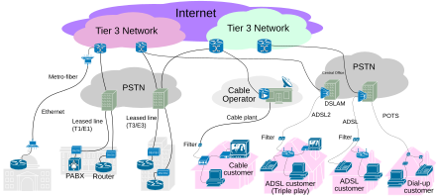
Connectivity & Infrastructure
6G Networks: Promising ultra-fast data speeds and seamless global connectivity.
Reconfigurable Intelligent Surfaces: Smart surfaces that enhance wireless communication

Slide 5

Biotech & Health
Smart Anti-Snore Pillows: Sensor-equipped pillows that gently adjust to reduce snoring.
Alternative Livestock Feeds: Sustainable feed options to reduce environmental impact.

Slide 6

AR/VR & Immersive Tech
Advanced AR/VR Applications: Enhanced virtual experiences for education, design, and healthcare.
Immersive Built World Tech: Augmented environments for architecture and urban planning.

Slide 7

📱 Materials & Devices
Transparent Aluminum Smartphones: Durable, lightweight materials for next-gen mobile devices.
Portable Methane Detection AI: Tools for detecting methane leaks from orbit

Slide 8
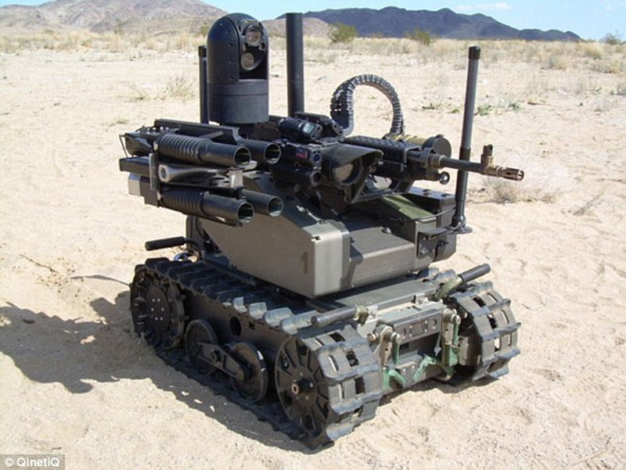
🧪 Digital Twins & Smart Systems
Digital Twin Technology: Virtual replicas of physical systems for real-time monitoring.
Roving Robotic AC Systems: Autonomous climate control units that adapt to surroundings.

